Slide 1
Tour Booking
Sai Kumar-sxs155933

Slide 2
Data Requirements
Entity | Entity | Relationship assumptions
customer | book tour | 1:m
customer | hotel | m:n
customer | flight booking details | 1:m
flight booking details | flight | m:1
booktour | canceltour | 1:1
hotel | city | n:1
booktour | tourpackage | m:1
tourpackage | city | m:n
travelagency | tourpackage | 1:n
tourguide | travelagency | m:n
staff | travelagency | n:1

Slide 3
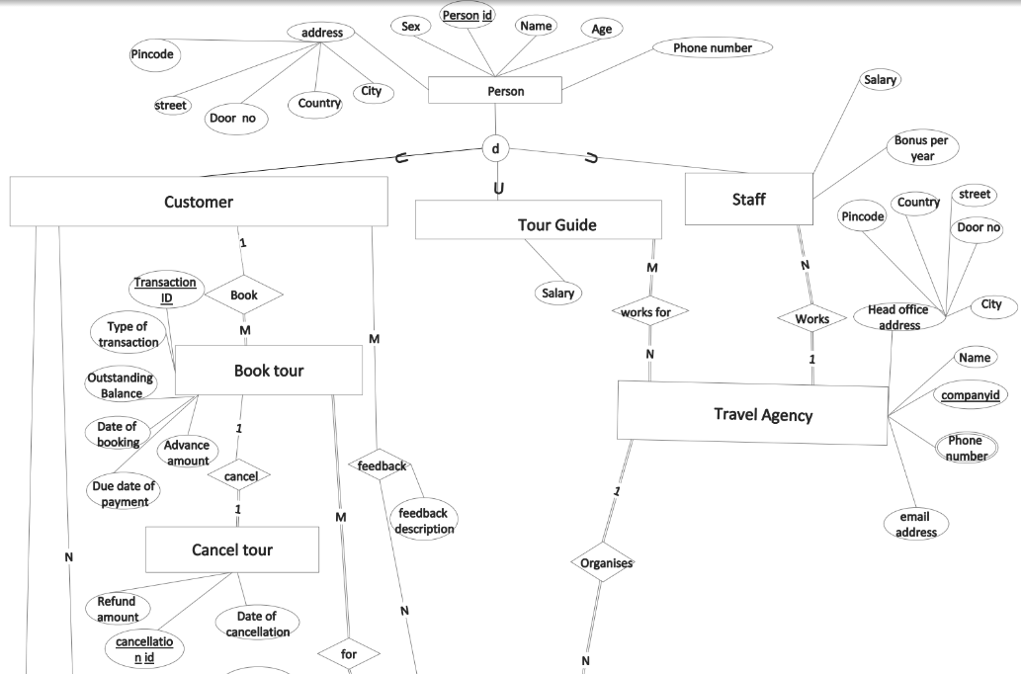
ER Diagram (Part 1)

Slide 4
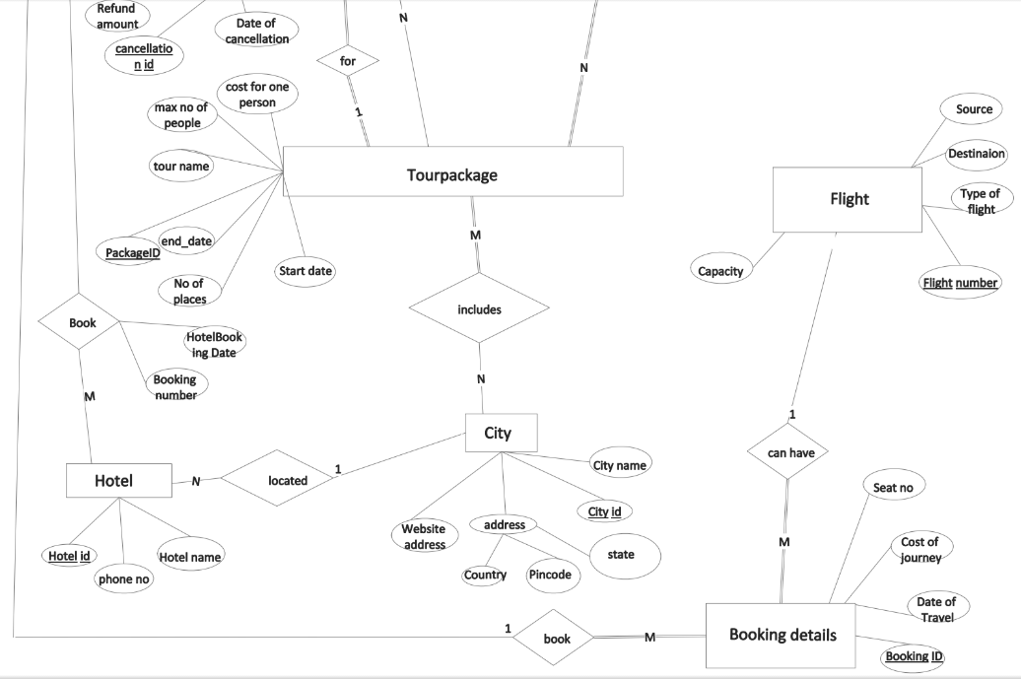
ER Diagram (Part 2)

Slide 5
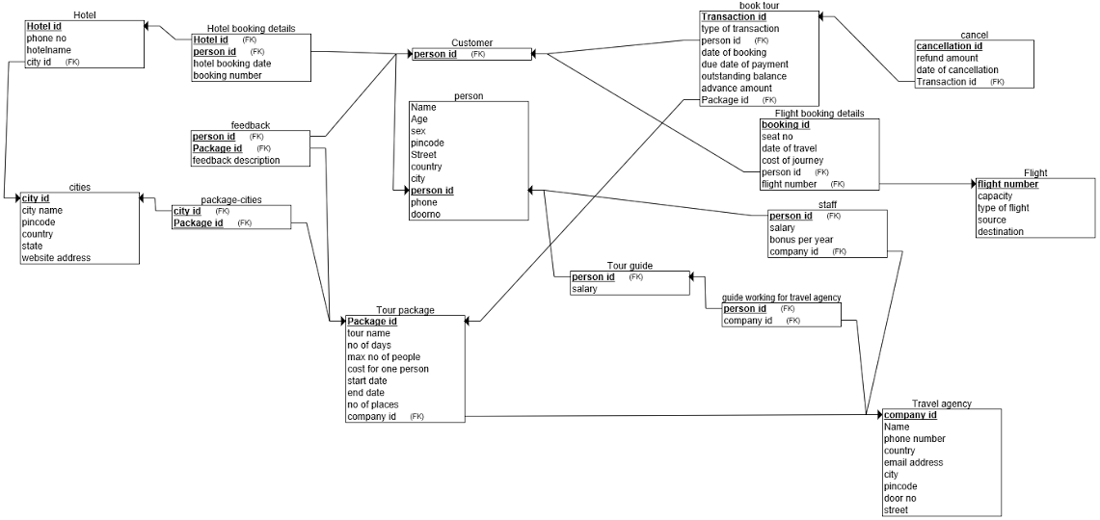
Original Relational Schema

Slide 6
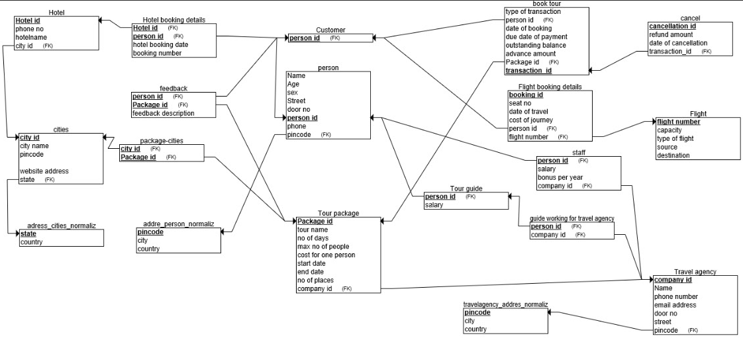
3NF Normalized

Slide 7
Tables
CREATE TABLE Person
(
Name varchar(300) NOT NULL,
PHONE int not null,
Age INT not null,
sex CHAR(1) NOT NULL,
pincode int not null,
Street VARCHAR (200),
door_no int ,
birthdate DATE NOT NULL,
person_id INT NOT NULL,
PRIMARY KEY (person_id)
);
CREATE TABLE travelagency_addres_normalized
(
pincode INT NOT NULL,
city CHAR(200) NOT NULL,
country CHAR(400) NOT NULL,
PRIMARY KEY (pincode)
);
CREATE TABLE adress_cities_normalized
(
state CHAR(400) NOT NULL,
country CHAR(400) NOT NULL,
PRIMARY KEY (state));
CREATE TABLE address_person_normalized
(
pincode INT NOT NULL,
city CHAR(400) NOT NULL,
country CHAR(400) NOT NULL,
PRIMARY KEY (pincode)
);

Slide 8
Tables
CREATE TABLE Customer
(
person_id INT NOT NULL,
PRIMARY KEY (person_id),
constraint customervsperson
foreign key (person_id)
references Person(person_id) on delete cascade
);
CREATE TABLE Tour_guide
(
salary INT NOT NULL,
person_id INT NOT NULL,
PRIMARY KEY (person_id),
constraint tourguidevsperson
foreign key (person_id)
references Person(person_id) on delete cascade
);
CREATE TABLE Book_tour
(
type_of_transaction VARCHAR(100) NOT NULL,
Transaction_id INT NOT NULL,
package_id int not null,
person_id INT NOT NULL,
date_of_booking DATE NOT NULL,
duedate_of_payment DATE NOT NULL,
outstanding_balance INT NOT NULL,
advance_amount INT NOT NULL,
PRIMARY KEY (Transaction_id),
constraint bookingvsperson
FOREIGN KEY (person_id) REFERENCES Customer(person_id)on delete cascade,
constraint bookingtourvspackage foreign key (package_id) References
tour_package(package_id)
on delete cascade
);

Slide 9
Tables
CREATE TABLE cancel_tour
(
cancellation_id int not null,
refund_amount INT not null,
date_of_cancellation DATE not null,
Transaction_id INT NOT NULL,
PRIMARY KEY (cancellation_id),
constraint cancellationvsbookingtour
FOREIGN KEY (Transaction_id) REFERENCES Book_tour(Transaction_id)on delete cascade
);
CREATE TABLE cities
(
city_id INT NOT NULL,
city_name VARCHAR(100) NOT NULL,
pincode INT,
state VARCHAR(100),
website_address VARCHAR(600),
PRIMARY KEY (city_id)
);
CREATE TABLE Flight
(
capacity INT,
flight_number VARCHAR(10) NOT NULL,
type_of_flight CHAR(50) NOT NULL,
source CHAR(10) NOT NULL,
destination CHAR(10) NOT NULL,
PRIMARY KEY (flight_number)
);
CREATE TABLE Travel_agency
(
Name CHAR(400) NOT NULL,
company_id INT NOT NULL,
phone_number VARCHAR(11),
email_address VARCHAR(400),
pincode VARCHAR(10),
door_no VARCHAR(10),
street VARCHAR(300),
PRIMARY KEY (company_id)
);

Slide 10
Tables
CREATE TABLE staff
(
salary INT,
bonus_per_year INT,
person_id INT NOT NULL,
company_id INT NOT NULL,
PRIMARY KEY (person_id),
constraint staffvsperson
FOREIGN KEY (person_id) REFERENCES Person(person_id) on delete cascade,
constraint staffvstravelagency
FOREIGN KEY (company_id) REFERENCES Travel_agency(company_id)on delete set null
);
CREATE TABLE Tour_package
(
Package_id INT NOT NULL,
tour_name VARCHAR(200) NOT NULL,
no_of_days INT,
max_no_of_people INT,
cost_for_one_person INT,
start_date DATE,
end_date DATE ,
no_of_places INT,
company_id INT NOT NULL,
PRIMARY KEY (Package_id),
constraint tourpackagevstravelagency
FOREIGN KEY (company_id) REFERENCES Travel_agency(company_id)on delete cascade
);

Slide 11
Tables
CREATE TABLE feedback
(
feedback_description VARCHAR(400),
person_id INT NOT NULL,
Package_id INT NOT NULL,
PRIMARY KEY (person_id, Package_id),
constraint feedbackvsperson
FOREIGN KEY (person_id) REFERENCES Customer(person_id) on delete cascade,
constraint feedbackvstourpackage
FOREIGN KEY (Package_id) REFERENCES Tour_package(Package_id)on delete cascade
);
CREATE TABLE Hotel
(
Hotel_id INT NOT NULL,
phone_no INT,
hotelname VARCHAR(200) NOT NULL,
city_id INT NOT NULL,
PRIMARY KEY (Hotel_id),
constraint cityvshotel
FOREIGN KEY (city_id) REFERENCES cities(city_id)on delete cascade
);

Slide 12
Tables
CREATE TABLE Hotel_booking_details
(
hotel_booking_date DATE NOT NULL,
booking_number INT NOT NULL,
Hotel_id INT NOT NULL,
person_id INT NOT NULL,
PRIMARY KEY (Hotel_id, person_id),
constraint hotelbookingvshotel
FOREIGN KEY (Hotel_id) REFERENCES Hotel(Hotel_id)on delete cascade,
constraint hotelbookingvsperson
FOREIGN KEY (person_id) REFERENCES Customer(person_id) on delete cascade
);
CREATE TABLE package_cities
(
city_id INT NOT NULL,
Package_id INT NOT NULL,
PRIMARY KEY (city_id, Package_id),
constraint packagecitiesvscities
FOREIGN KEY (city_id) REFERENCES cities(city_id) on delete set null,
constraint packagecitiesvstoupackage
FOREIGN KEY (Package_id) REFERENCES Tour_package(Package_id)on delete set null
);

Slide 13
Tables
CREATE TABLE Flight_booking_details
(
seat_no INT,
booking_id INT NOT NULL,
date_of_travel DATE,
cost_of_journey INT,
person_id INT NOT NULL,
flight_number VARCHAR(10) NOT NULL,
PRIMARY KEY (booking_id),
constraint flightbookingvsperson
FOREIGN KEY (person_id) REFERENCES Customer(person_id) on delete cascade,
constraint flightbookingvsflight
FOREIGN KEY (flight_number) REFERENCES Flight(flight_number) on delete cascade
);
CREATE TABLE guide_travel_agency
(
person_id INT NOT NULL,
company_id INT NOT NULL,
PRIMARY KEY (person_id, company_id),
FOREIGN KEY (person_id) REFERENCES Tour_guide(person_id) on delete cascade,
FOREIGN KEY (company_id) REFERENCES Travel_agency(company_id)on delete set null
);

Slide 14
Procedure 1
This procedure returns hotel bookings in past 6 months.
CREATE OR REPLACE PROCEDURE SIX_MONTH_HOTEL
IS
CURSOR HOTEL_DETAILS IS
SELECT NAME, HOTELNAME
FROM HOTEL H , HOTEL_BOOKING_DETAILS H2, PERSON P
WHERE TRUNC(H2.HOTEL_BOOKING_DATE)>=TRUNC(SYSDATE-180) AND H2.HOTEL_ID=H.HOTEL_ID
AND P.PERSON_ID=H2.person_ID;
THISNAME VARCHAR(30);
THISHOTELNAME VARCHAR(200);
BEGIN
OPEN HOTEL_DETAILS;
LOOP
FETCH HOTEL_DETAILS INTO THISNAME, THISHOTELNAME;
EXIT WHEN (HOTEL_DETAILS%NOTFOUND);
DBMS_OUTPUT.PUT_LINE('Name of customer is:'||THISNAME||' and Name of hotel is:'||THISHOTELNAME);
END LOOP;
CLOSE HOTEL_DETAILS;
END;

Slide 15
Procedure 2
This procedure gets the names of cities which are visited by the customers
for the given package organized by the particular travel agency.
create or replace procedure cities(agencyname in char, packagename in varchar) as
cursor cities is
select p.name person_name,c1.city_name,a.name , t.tour_name
from customer c,person p,travel_agency a,book_tour b, tour_package t ,cities
c1,package_cities p1
where b.package_id=t.package_id and t.company_id=a.company_id and a.name=agencyname
and
t.tour_name=packagename and c.person_id=b.person_id and
c.person_id=p.person_id and t.package_id=p1.package_id and p1.city_id=c1.city_id;
cityy cities%rowtype;
begin
open cities;
loop
fetch cities into cityy;
exit when cities%NOTFOUND;
dbms_output.put_line('travel agency name: '|| cityy.name|| 'and
citynames:'||cityy.city_name||' and package name: '||cityy.tour_name||'and customer name:
'||cityy.person_name);
end loop;
close cities;
end;

Slide 16
Procedure 3 Part 1
To get the most popular(most booked) package name and the customer names
who booked that package.
Create or replace procedure TOP_PACKAGE IS
CURSOR PACKAGE IS select t1.tour_name, p.name from (select pkg_id from
(( select p.package_id pkg_id,
count(*) cnt
from tour_package p, book_tour b
where b.transaction_id not in (select c.transaction_id from cancel_tour c) and
p.package_id=b.package_id
group by p.package_id
) where
cnt=(select max(cnt) from
( select p.package_id pkg_id,
count(*) cnt
from tour_package p, book_tour b
where b.transaction_id not in (select c.transaction_id from cancel_tour c) and
p.package_id=b.package_id
group by p.package_id
)
))

Slide 17
Procedure 3 Part 2
To get the most popular(most booked) package name and the customer names
who booked that package.
))t, book_tour b,person p ,tour_package t1
where t.pkg_id=b.package_id and p.person_id=b.person_id and t1.package_id=t.pkg_id;
thistourname varchar(150);
thisname varchar(200);
BEGIN
OPEN package;
LOOP
FETCH package INTO thistourname,thisname;
EXIT WHEN (package%NOTFOUND);
dbms_output.put_line('tour name:'|| THIStourNAME||' customer name: '|| THISname);
END LOOP;
CLOSE package;
END;

Slide 18
Trigger 1
This is the trigger to delete the transactions permanently from the database if the no of cancellations in the cancelled table is more than 5000.
CREATE or replace TRIGGER deletion
BEFORE insert ON cancel_tour
for each row
declare
thisnumber int;
begin
SELECT count(*)into thisnumber
FROM cancel_tour c;
if(thisnumber>5000)then
delete from book_tour b where b.transaction_id in
(select c.transaction_id from cancel_tour c, book_tour b where
c.transaction_id=b.transaction_id);
end if;
if (thisnumber>5000)
then
delete from cancel_tour c;
end if;
end;

Slide 19
Trigger 2
This is the trigger to increase the bonus of the staff if the corresponding company have 10000
bookings.
CREATE OR REPLACE TRIGGER bonus_updates
before INSERT
ON book_tour
FOR EACH ROW
BEGIN
update staff s
set bonus_per_year=bonus_per_year+'5000'
where s.company_id in
(select p.company_id
from
book_tour b, tour_package p
where b.transaction_id not in (select c.transaction_id from cancel_tour c) and
b.package_id=p.package_id
group by p.company_id
having count(p.company_id)=10000);
END;

